Slide 1
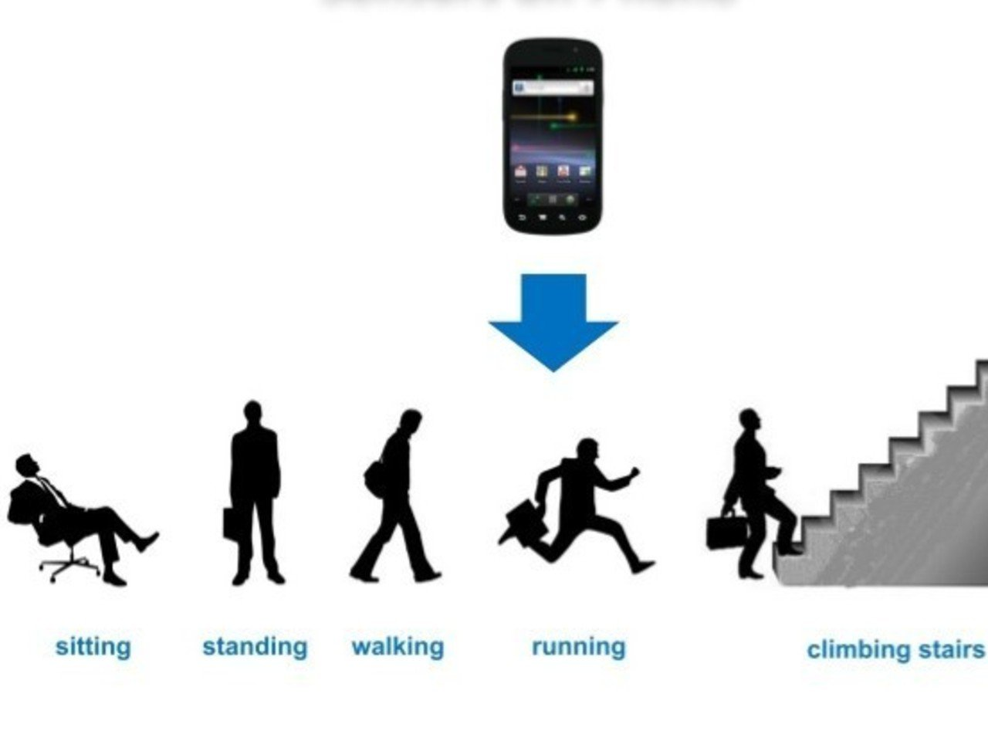
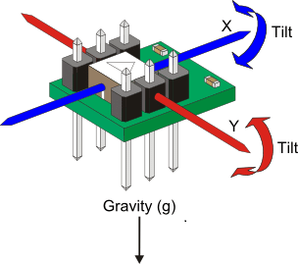

Human Activity Recognition using Accelerometer Data

Slide 2
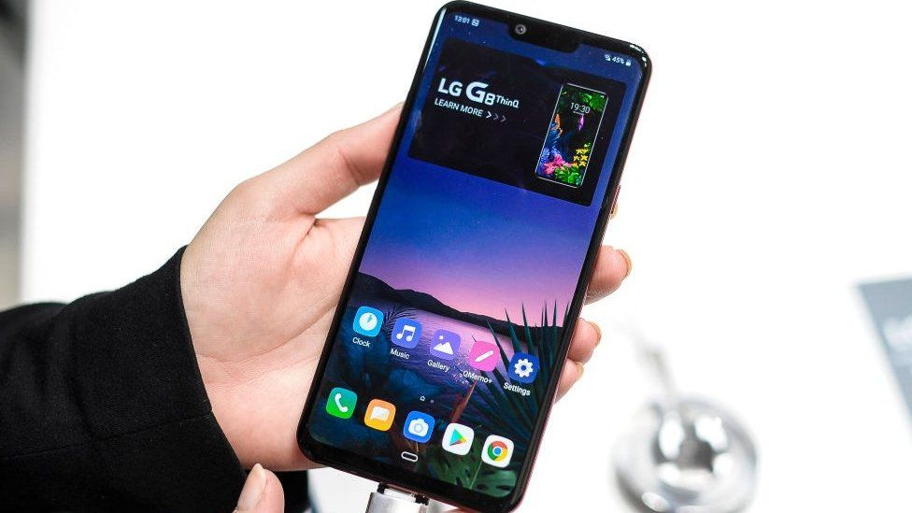
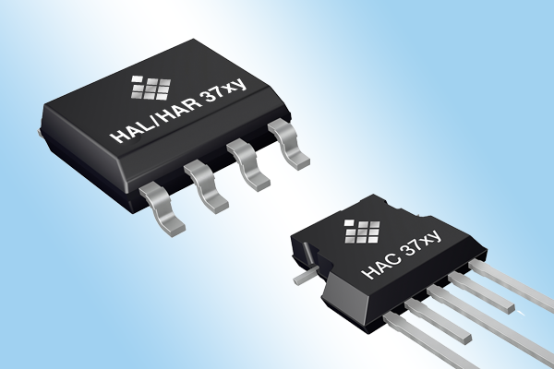
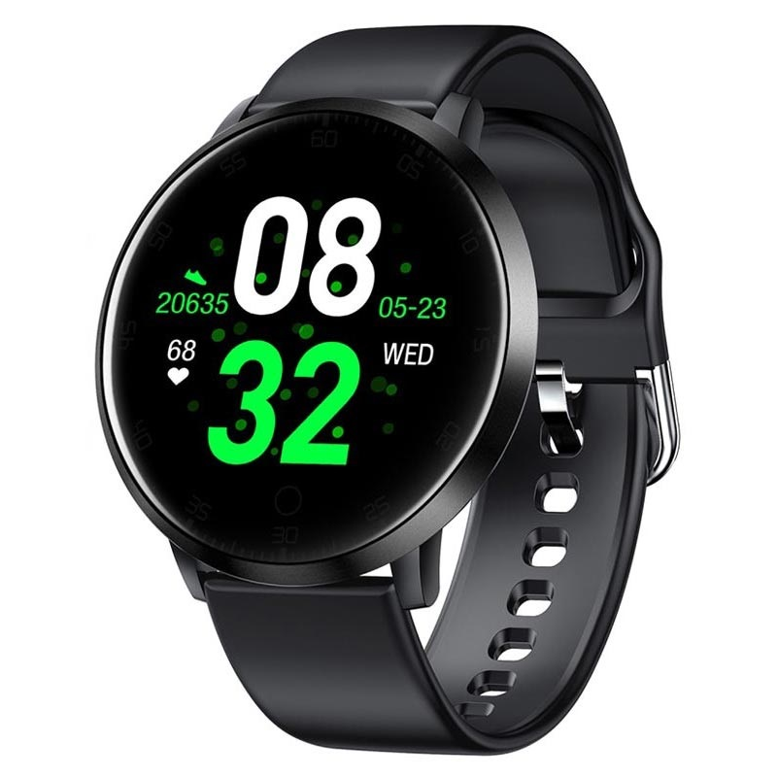
Introduction
Predicting a person’s posture, movement or behaviour using sensors.
Predicted using smartphones, smart watches, on-body sensors, or environment sensors.
Applications include context awareness, human-computer interactions, smart homes, healthcare, and security control.
Study aims at discovering the ability of ANN’s to classify activities.
CNN’s and RNN’s are contrasted and compared with related works.

Slide 3
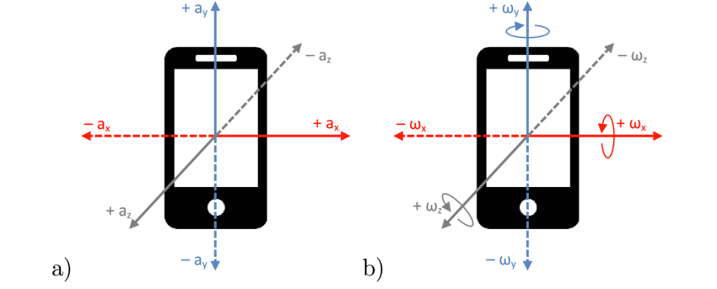
What are Accelerometers?
An electronic sensor that measures the acceleration forces acting on an object.
Determines the object’s position in space and monitors the object’s movement.
Two types of forces: Static and Dynamic
Static forces: Constantly applied to object (such as friction or gravity)
Dynamic forces: “Moving” forces applied to the object at various rates (such as vibration or Newtons 2nd Law)

Slide 4
Literature Review and Related Works

Slide 5
Study 1:
Tri-axial accelerometers were placed on the chest, wrist, lower back, hip, thigh and foot.
Activities included walking, running, sitting, lying, standing, walking upstairs, walking downstairs.
Models used include: Decision Trees, Naïve Bayes, Neural Network, and Support Vector Machine.
SVM > NN > NB > DT.
Hip placement performed the best, foot and wrist performed the worst.
Fewer sensors meant better accuracy, however more than 1 is efficient.

Slide 6
Study 2:
Sensor data included a tri-axial accelerometer, a gyroscope and a magnetic field sensor.
Activities included descending stairs, ascending stairs, walking, jogging and jumping.
5 positions: right upper arm, right hand, right jacket pocket, right trousers pocket, and waist.
Classifiers: Nearest Neighbour, Random Forests, Support Vector Machines.
3 conditions: one-to-one, all-to-one, rest-to-one.
Thigh placement is the best.
RF’s are the most efficient because of feature selection and fewer parameters.
All-to-one and rest-to-one are the best.
Combination of gyroscope and accelerometer gives higher accuracy.

Slide 7
Study 3:
Three datasets: WISDM, Daphnet, and Skoda.
WISDM: activities included: walking, jogging, sitting, standing, and climbing stairs.
Daphnet: accelerometers placed on ankle, upper leg, and trunk. Labels: “freezing” or “no freezing”.
Skoda: 10 distinctive activities belonging to car maintenance.
Classifiers: Deep learner, Multi-Layer Perceptron, Ensemble Learner.
DL’s performed better than MLP’s and Ensemble Learners.
Deep Models are better than shallow models.
Semi-Supervised Learning is better as it includes generative training.
Spectogram signals better than raw acceleration.
Hybrid DL-HMM outperforms HMM.

Slide 8
Study 4:
Static Postures: standing, sitting, lying.
Dynamic motions: walking, running, stair climbing, cycling.
5 bi-axial accelerometers located at the hip, wrist, arm, ankle, and thigh.
Elementary activities and composite activities.
Distinct classifiers for each individual subject.
Classifiers: probabilistic, geometric and binary decision.
A first phase training and second phase training gave good results as opposed to just first.
Nearest mean performed the best indicating the relevance of exploiting statistical knowledge
cHMM based sequential classifier > simple single frame GMM

Slide 9
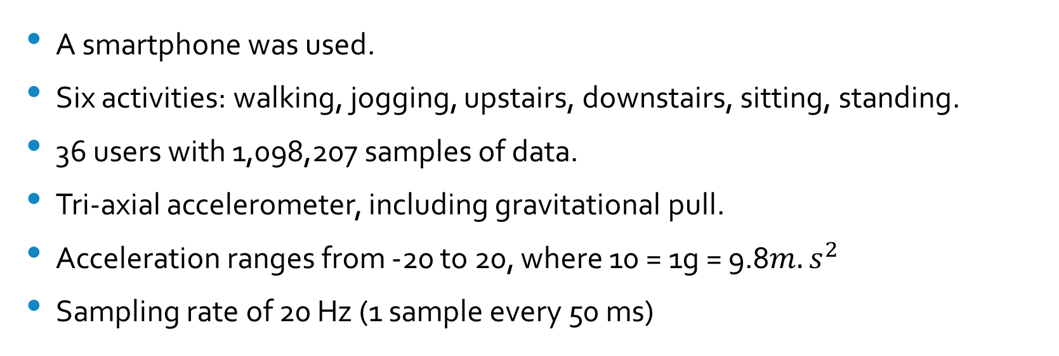
Dataset and Metrics
A smartphone was used.
Six activities: walking, jogging, upstairs, downstairs, sitting, standing.
36 users with 1,098,207 samples of data.
Tri-axial accelerometer, including gravitational pull.
Acceleration ranges from -20 to 20, where 10 = 1g = 9.8$m.s^{2}$
Sampling rate of 20 Hz (1 sample every 50 ms)

Slide 10
Convolutional Neural Network
Takes as input, a 3 dimensional matrix or vector.
Uses a kernel to convolve the matrix.
Is composed of multiple layers of artificial neurons.
Artificial neurons calculate the weighted sum of multiple inputs and outputs an activation value.
Has convolutional and pooling layers.
Two types of pooling layers: max pooling and average pooling.
Max pooling is better.
Limitations: noise in input data will go unnoticed because of adversarial attacks.

Slide 11
Recurrent Neural Network
Uses-time series or sequential data.
Different because of “memory”. The outputs depend on prior elements within the sequence.
Shares parameters across each layer of the network.
Shared weights are adjusted through backpropagation and gradient descent to facilitate reinforcement learning.
BPTT calculates errors from its output layer to its input layer.
An LSTM is used for long-term dependencies.
LSTM’s have cells in hidden layers to fix this problem.
Three gates are used: an output gate, an input gate and a forget gate.
These gates control the flow of information.

Slide 12
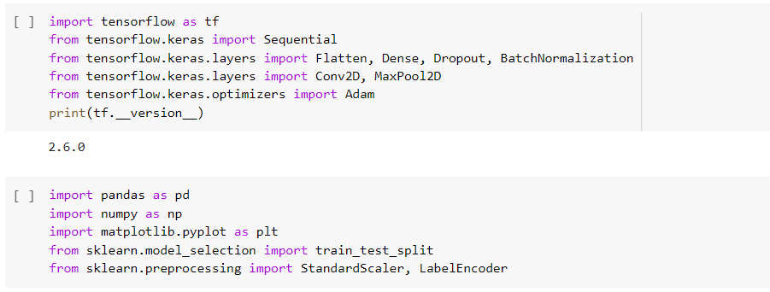
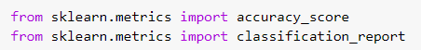
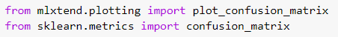
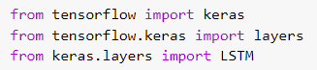
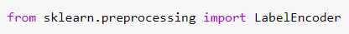
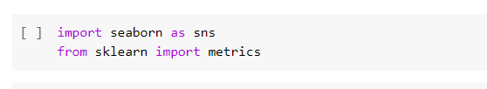

Code Discussion

Slide 13
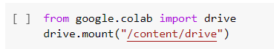
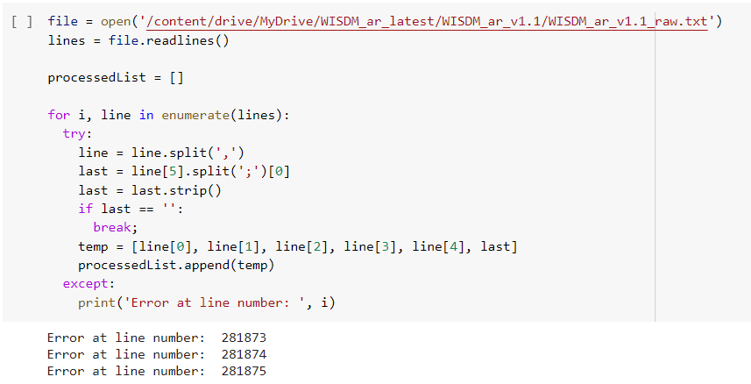
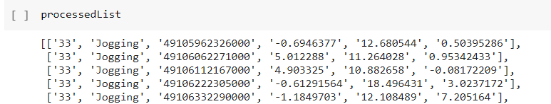

Slide 14
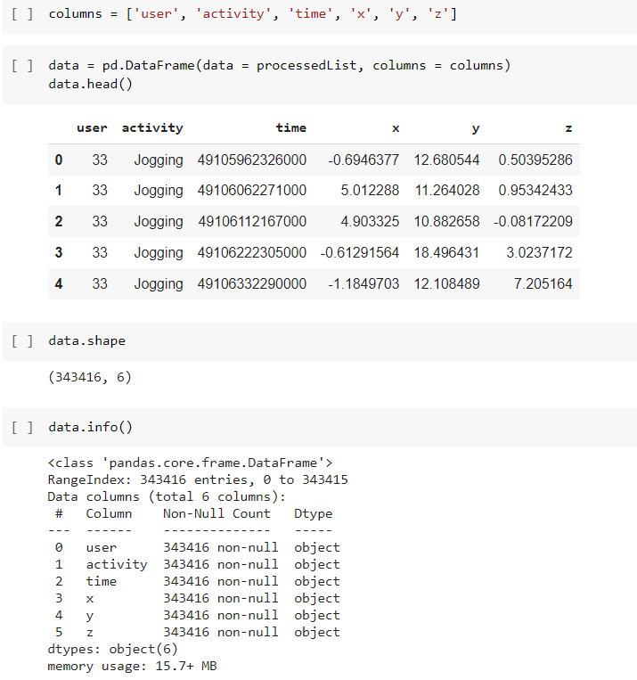
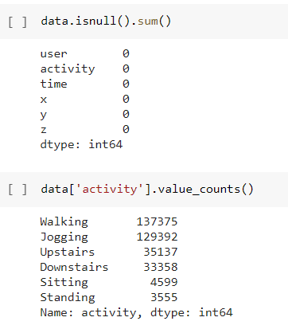

Slide 15
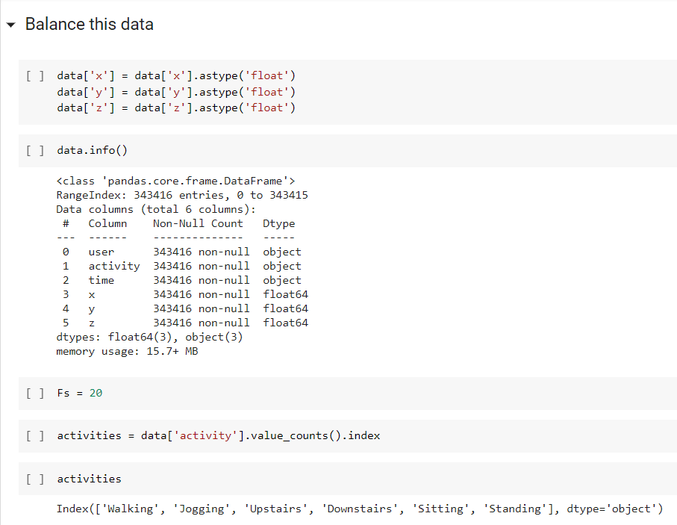

Slide 16
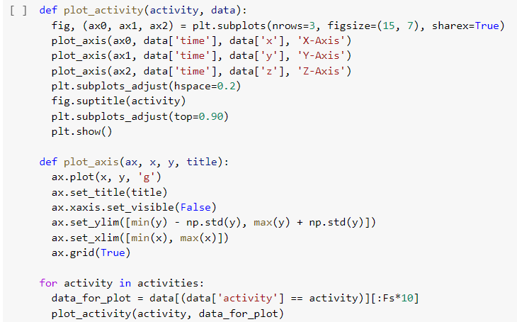

Slide 17
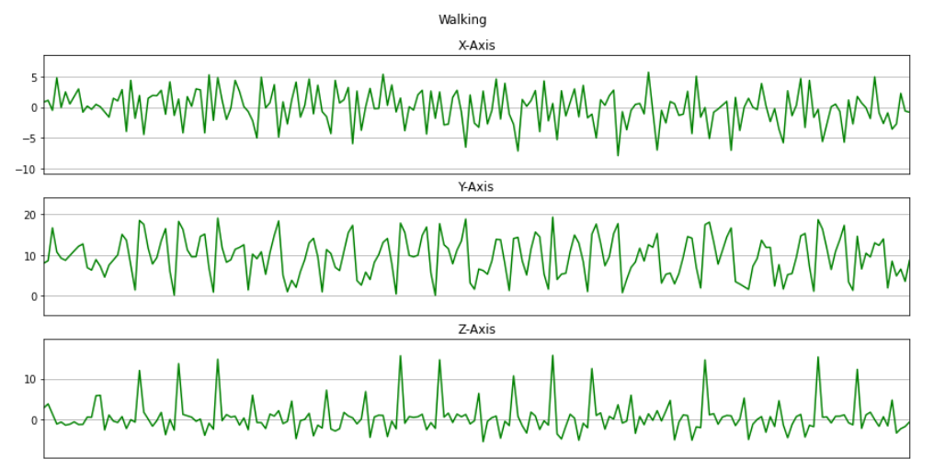
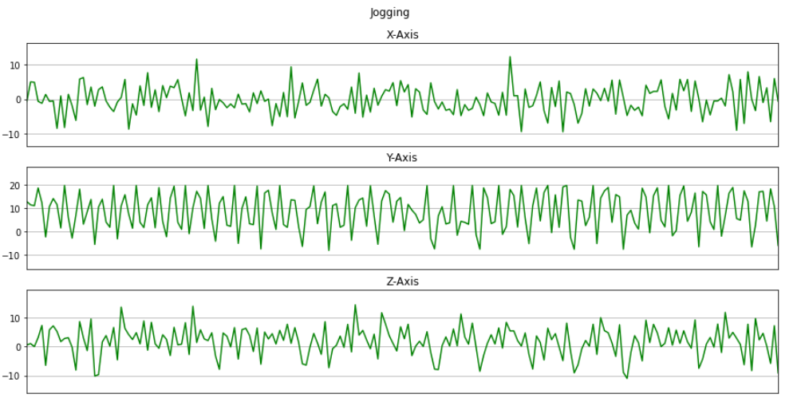
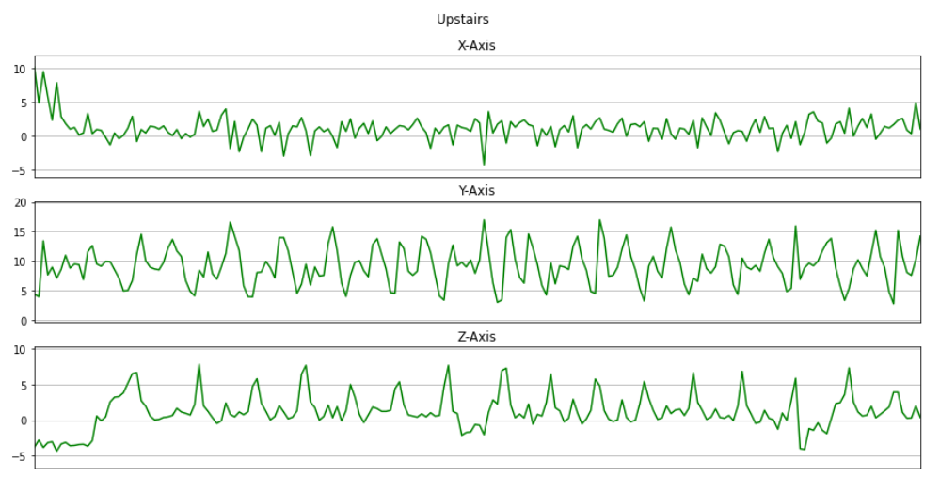
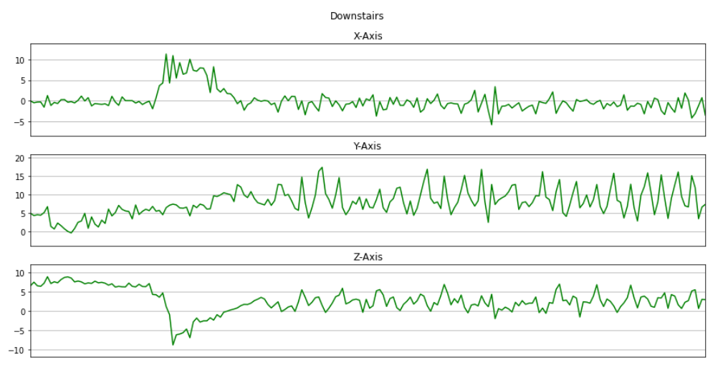
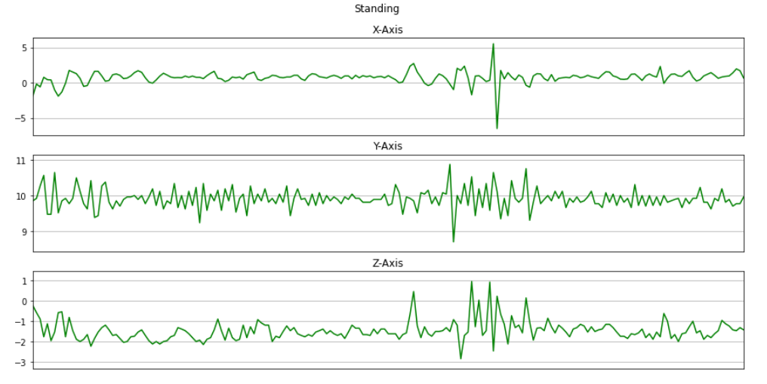
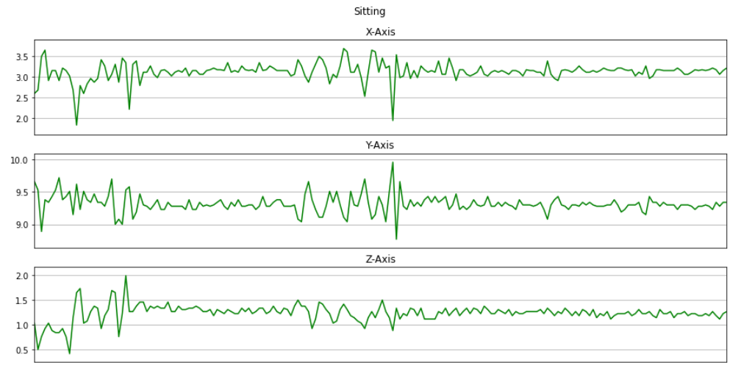

Slide 18
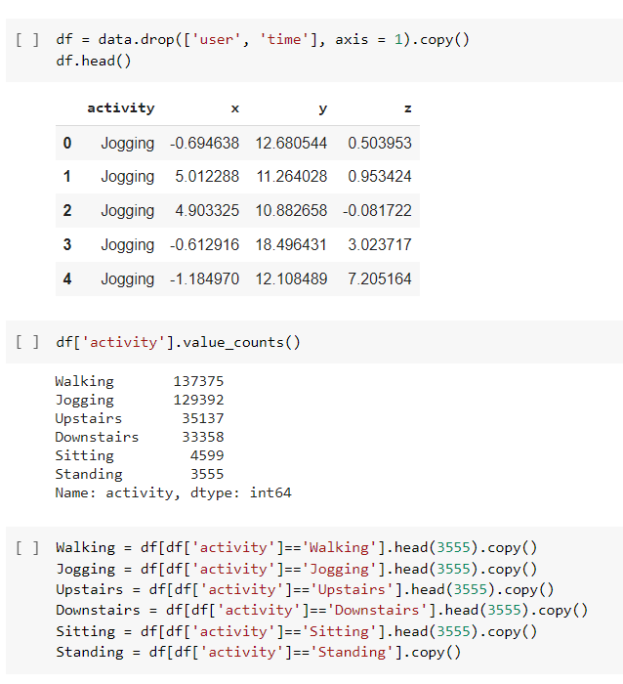

Slide 19
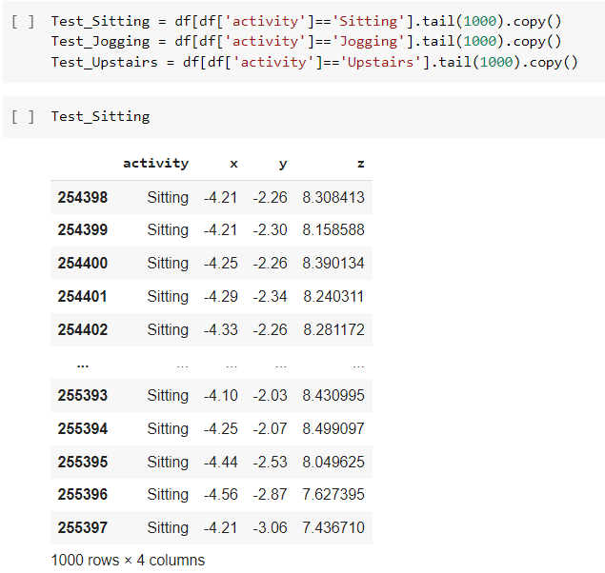
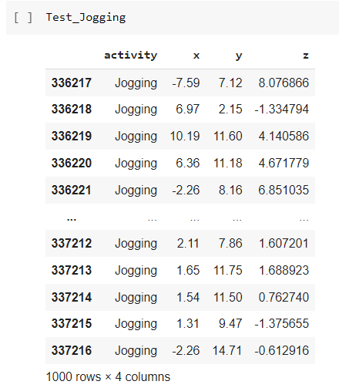
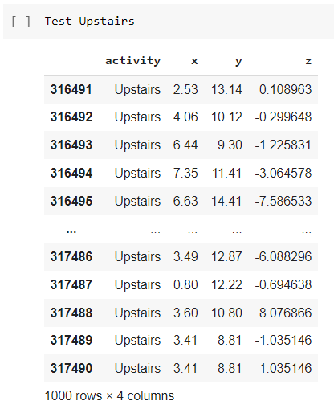

Slide 20
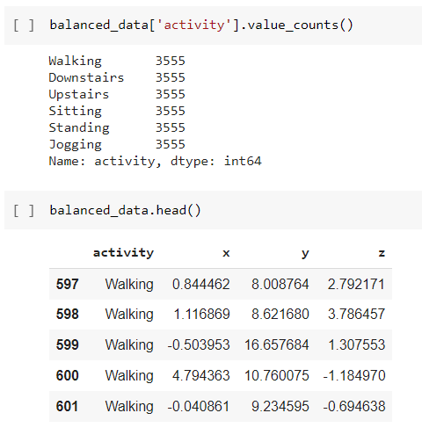
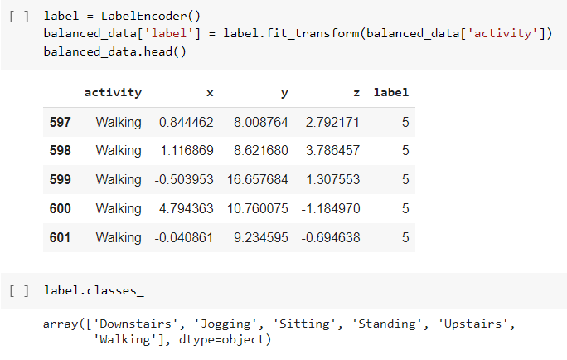

Slide 21
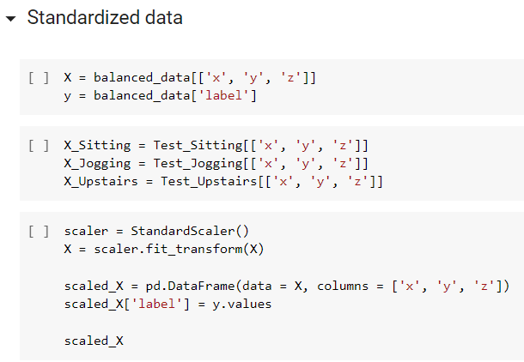
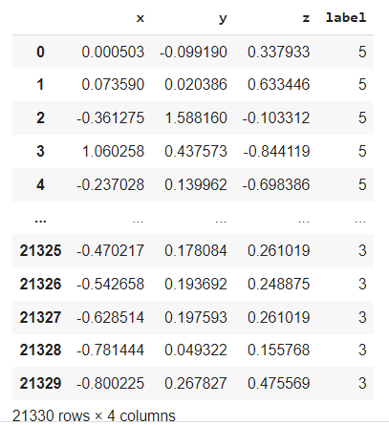

Slide 22
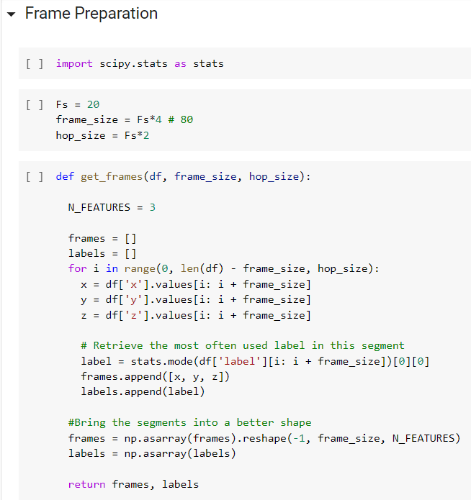

Slide 23
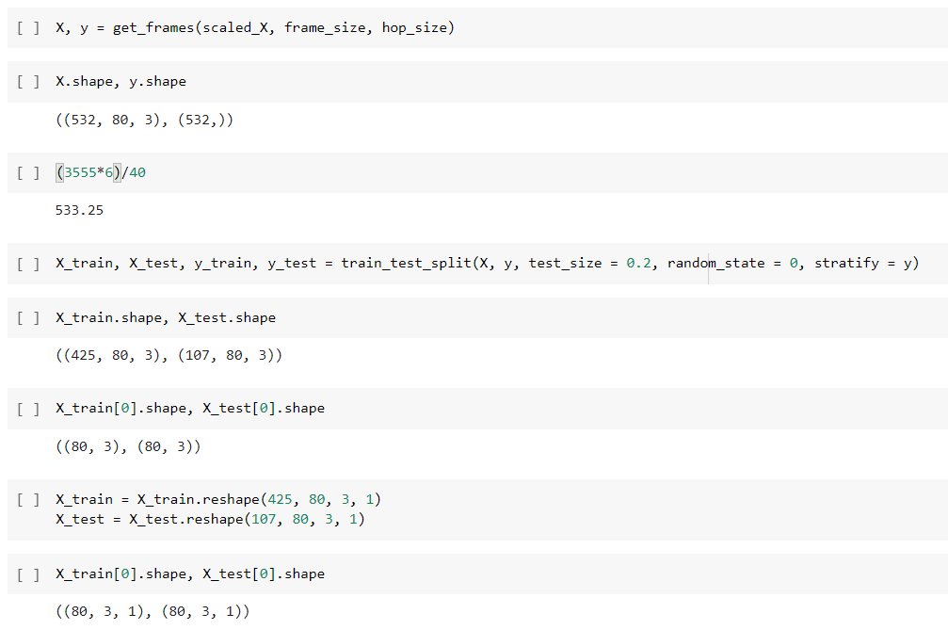

Slide 24
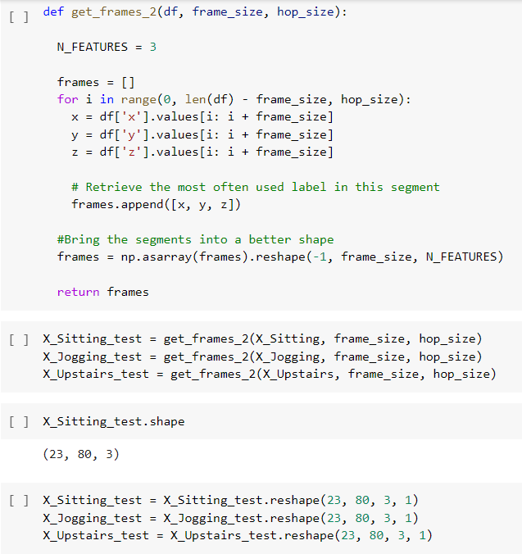

Slide 25
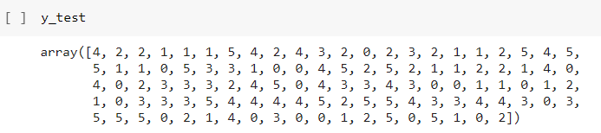
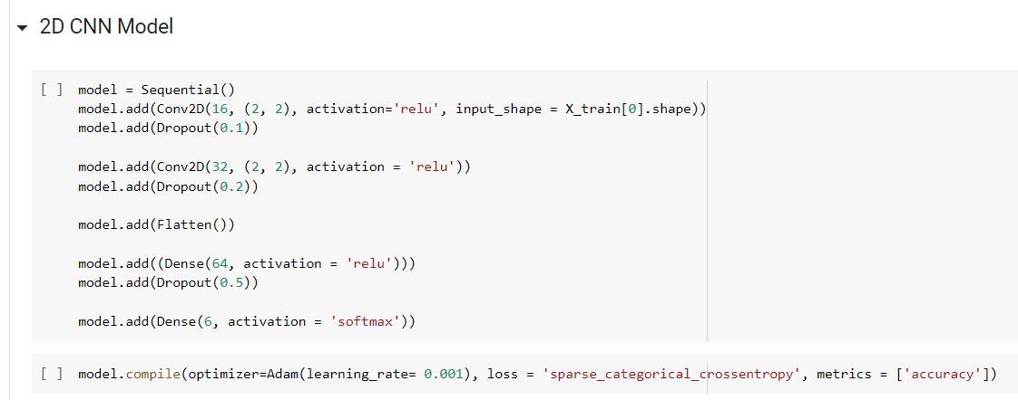

Slide 26
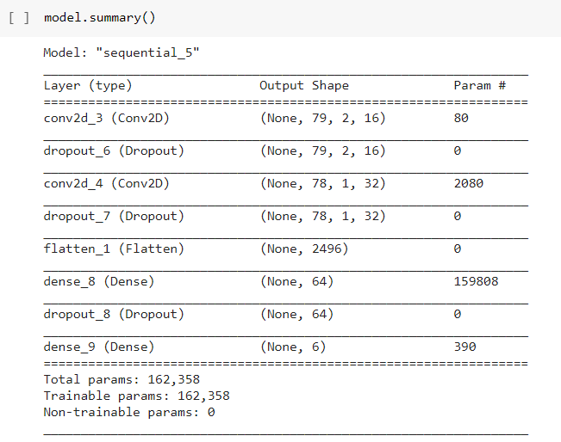

Slide 27
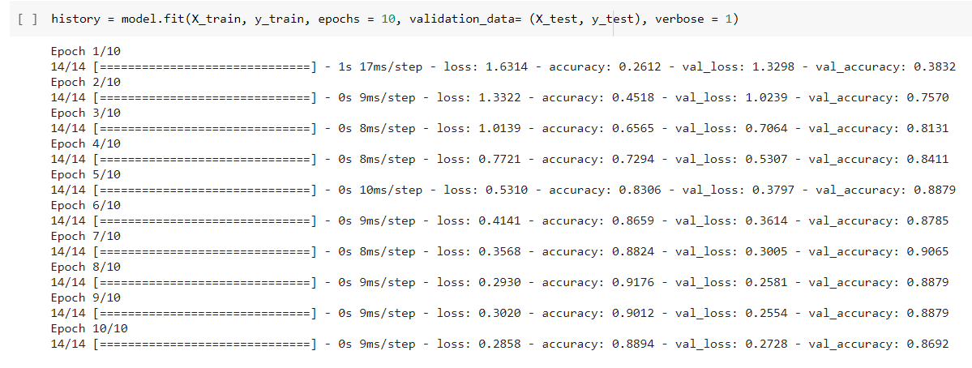

Slide 28
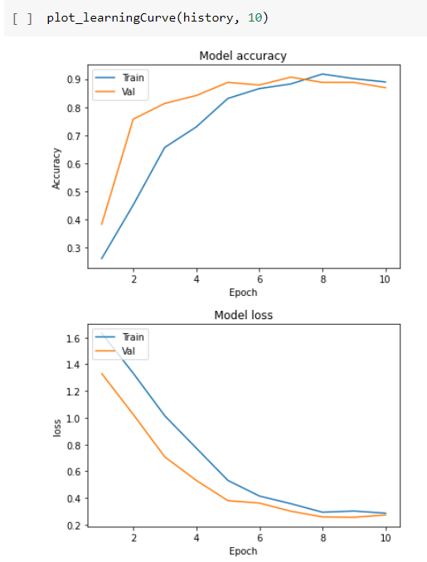
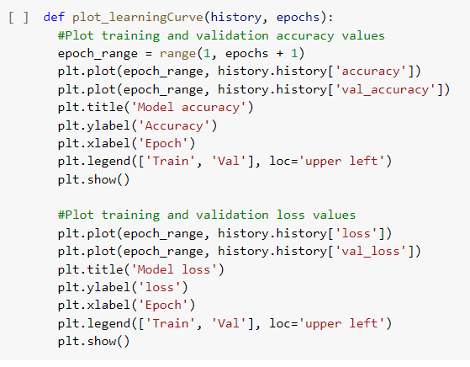

Slide 29
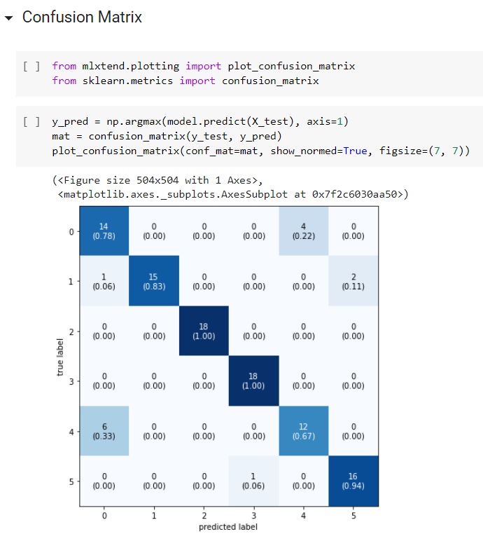
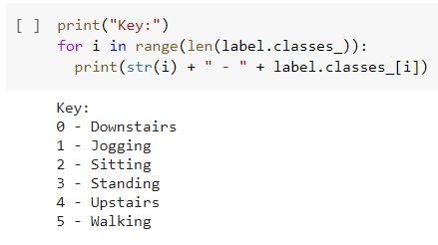

Slide 30
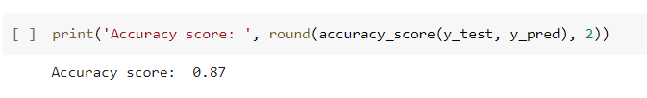
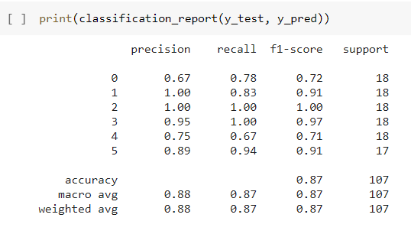

Slide 31
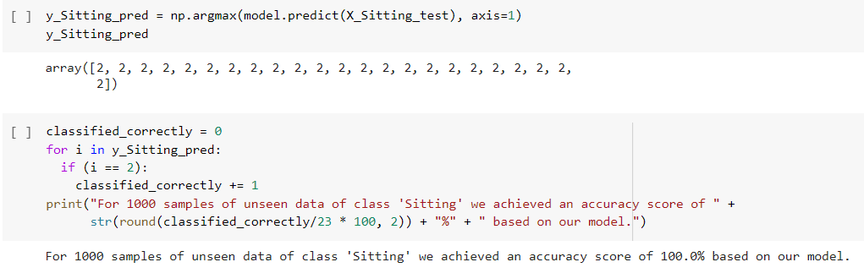

Slide 32
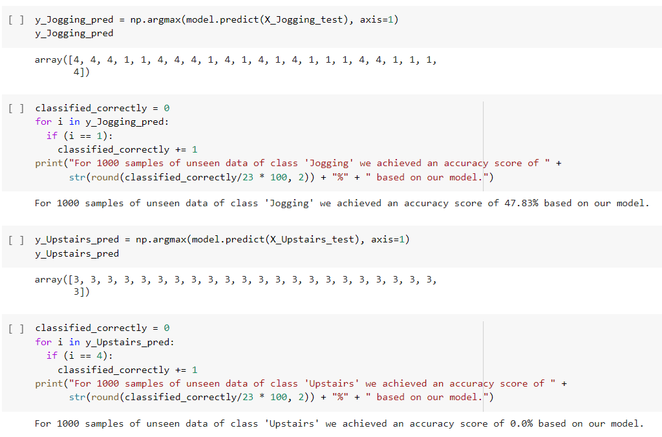

Slide 33
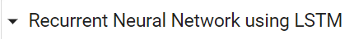


Slide 34


Slide 35


Slide 36



Slide 37
Results and Conclusion
Standing, Jogging, Sitting, Walking are highly accurate for both models.
Jogging and Walking slightly more accurate in RNN than CNN.
Upstairs and Downstairs are difficult to classify because of similar gravitational motions in both models.
Upstairs and Downstairs in CNN are classified better than in RNN.
Our study lacks training data, data status and accelerometer positioning is unclear.
Thigh placement is the most accurate.
Two sensors are better than one.
The more datasets the better, the more subjects the better.

Slide 38
Ensemble methods perform better than separation of models, but not better than DL’s.
SVM, HMM and DNN can perform better than just ANN.
The deep learning RNN used in our study proved that our data has noise.
Deep networks are better than shallow networks.
Tri-axial accelerometers are better than bi-axial accelerometers.
Static postures are easier to classify than dynamic postures.
A balanced dataset is better.
Future studies should combine more sensors.
Future studies should use different applications and try different environments.

